Slide 1
Accelerate Data Science Workflows with Zero Code Changes
NVIDIA Deep Learning Institute

Slide 2
Data Science Workflow
Data Loading & ETL
Model Training & Analytics
Model Inference & Deployment
Data Acquisition
Data Cleaning
Data Preprocessing
Visualization
Model Training
Model Evaluation
Model Deployment
Model Management
Monitor and Maintain

Slide 3


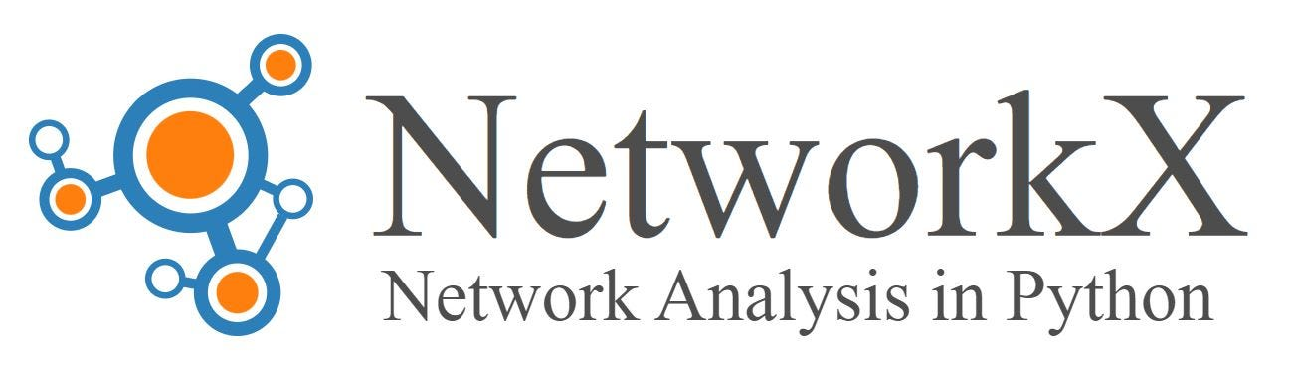



Data Science Tools
Data Loading & ETL
Model Training & Analytics
Model Inference & Deployment
Data Acquisition
Data Cleaning
Data Preprocessing
Visualization
Model Training
Model Evaluation
Model Deployment
Model Management
Monitor and Maintain

Slide 4











Data Science Can Be Accelerated End-to-End Today
Data Loading & ETL
Model Training & Analytics
Model Inference & Deployment
RAPIDS cuDF
Deep Learning
Triton
Tabular Data Loading and Processing
Frameworks, SDKs and Models
Open Source Inference Serving
RAPIDS for Apache Spark
RAPIDS cuML
RAPIDS RAFT
Apache Spark Accelerator
Machine Learning Toolkit
Vector Search & ML
NeMo Data Curator
RAPIDS cuGraph
Enabling high-quality dataset for LLMs
Large Scale Graph Analytics
NVIDIA AI Enterprise
Development Tools | Cloud Native Management and Orchestration | Infrastructure Optimization
Cloud
Data Center
Edge
RTX Laptop

Slide 5
Adoption to New Tools Can Be a Challenge
API Coverage
Problem: learning new APIs takes time
Compatibility
Problem: using new tools for each stage of the workflow may adversely impact downstream processes
Specific Hardware Availability
Problem: hardware-acceleration requires the specific hardware for testing and development
Solution: RAPIDS integrates with libraries within the PyData ecosystem to provide acceleration with zero code change

Slide 6
Accessibility to GPU-Acceleration via RAPIDS
Over time, RAPIDS will become more available as it seamlessly integrates with the ecosystem
Three specific features to highlight:
cuDF
cuML
cuGraph

Slide 7
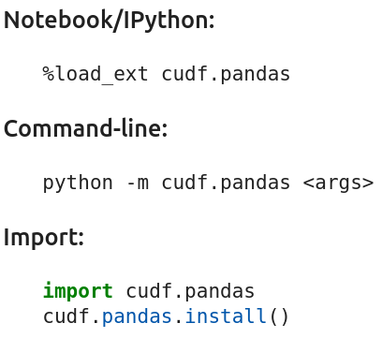
cuDF pandas accelerator mode (cudf.pandas)
Bringing world-class performance to pandas workflows
Zero Code Change Acceleration
Write your code with the full flexibility of pandas. Just load cudf.pandas to accelerate on the GPU, with automatic CPU fallback if needed.
Third-Party Library Compatible
Pass Pandas objects to third-party libraries in cudf.pandas mode and things just work. It will even accelerate pandas operations within these libraries.
One Code Path
Develop, test, and run in production with a single code path, regardless of hardware.
Designed to Accelerate the Entire pandas Ecosystem
Bringing the speed of cuDF to pandas users and the ecosystem built for them.
Standard DuckDB Database-like Ops Benchmark (5GB)
HW: NVIDIA Grace Hopper, CPU: Intel Xeon Platinum 8480CL
SW: pandas v1.5, RAPIDS cuDF 23.10

Slide 8


The cuGraph Backend for NetworkX
Bringing GPU-accelerated graph analytics to every NetworkX user
Zero Code Change Acceleration
Just configure NetworkX to use the cuGraph backend through environment variables
One Code Path
Develop, test, and run in production with a single code path, regardless of hardware.
2 hour 30 mins
sec
2 hour 45 mins
sec
47 mins
sec
+
nx-cugraph on NVIDIA H100 vs. NetworkX on Intel Xeon Platinum 8480CL CPU
Dataset: US Patents hosted by Stanford Snap
Up to 600X Faster

Slide 9
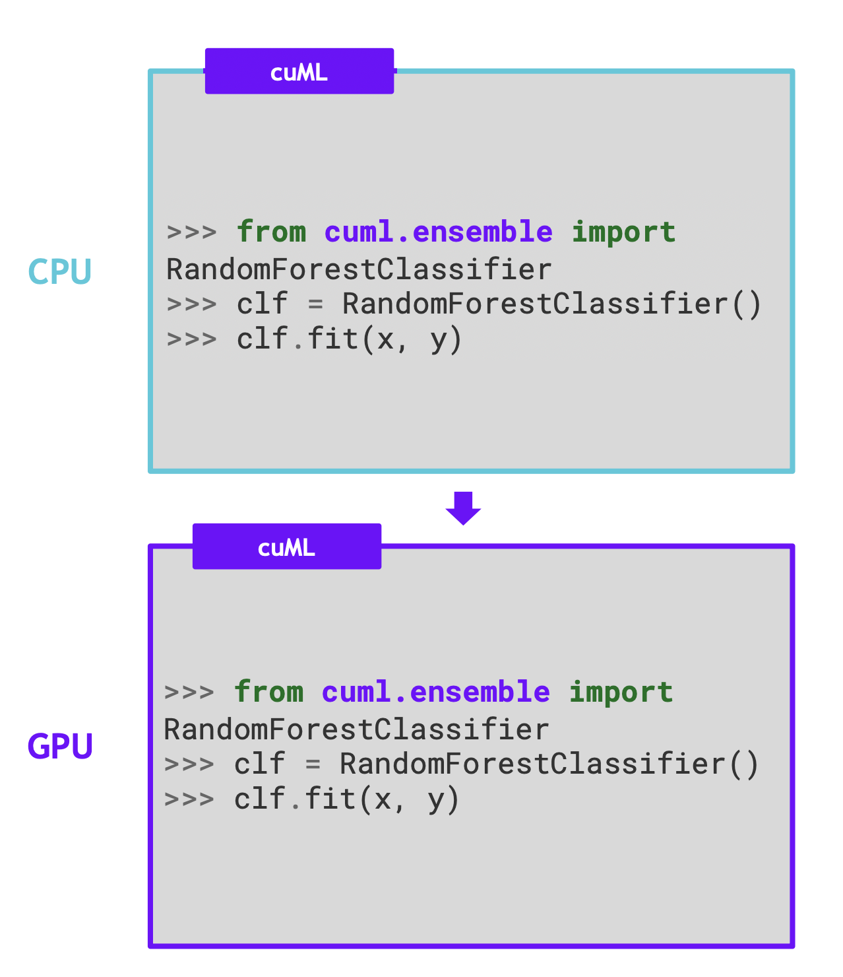
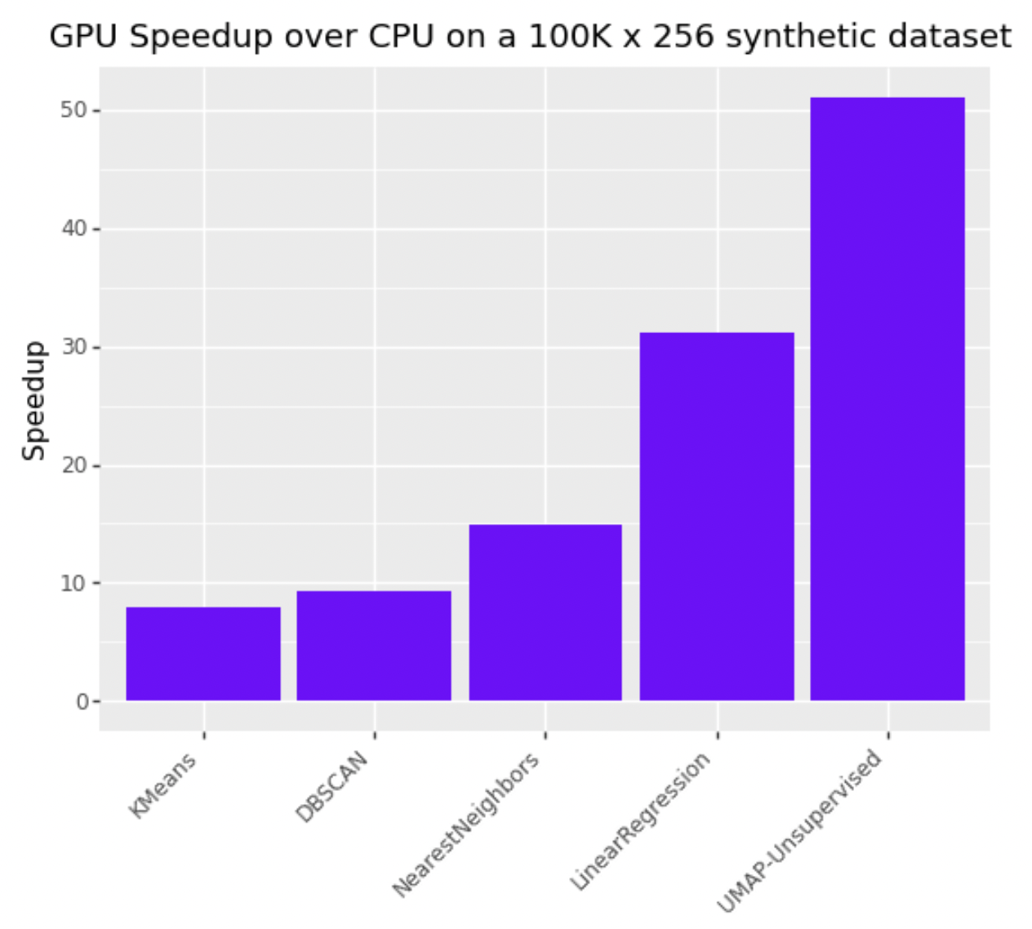
A Unified CPU and GPU cuML Experience
Making accelerated machine learning accessible to every data scientist
NVIDIA H100 vs. Intel Xeon Platinum 8480CL
cuML Python vs. Scikit-learn

